Slide 1
Fake News Detection
By
Alasyam Sai Teja
11912082
CS-B-05
SUBMITTED TO
Dr. M.K. Murmu
ASST. PROF.

Slide 2


Slide 3
INTRODUCTION
Data has been increasing at an unprecedented range in an exponential manner and is producing 2.7 quintillion data everyday.
The definition of Fake News is information that pushes people down the wrong road. It is spreading like a wildfire nowadays. It is frequently done to impose specific views.
As a result, it is vital to recognise fake news.

Slide 4
PROBLEM DEFINITION
1
Fake news have become more prevalent in recent years and with great amount of dynamism in internet and social media, differentiating between facts and opinions, relating to commercial or political upheavals has become more difficult than ever.
2
Fake information is purposely or intentionally spread throughout the internet. The massive dissemination of fake news has left an inedible mark on people and culture.
We use various NLP and pre-processing methodologies like tokenization, stop words removal, lemmatization, stemming and machine learning classification algorithms - Pac, naive bayes, perceptron and sgd classifier, to build a model that differentiates between fake news and real news and also analyse the performance of these various classification methodologies to choose the best classifier on our dataset.
3

Slide 5
Why is Detecting Fake News important?
98000
160
Tweets are shared on twitter.
Million emails are sent.
600
1500
Videos are uploaded on
Youtube.
Blog entries are created.
11
600,000
Million instant messages are sent.
Facebook Status updates and posts are created.
For every 60 seconds

Slide 6
TYPES OF DATA IN SOCIAL MEDIA POSTS
Text: Computational linguistics analyses text, focusing on the genesis of text semantically and methodically. Because many of the posts are written in the form of texts, much work has been caried out into analysing them.
Multimedia: Several types of media are combined in a single post. Audio, video, photos, and graphics may all be included. This is highly appealing, because it captures the attention of the visitors without requiring them to read the content.
Hyperlinks: Hyperlinks allow the post's creator to cross-reference to other sources, gaining viewers' trust by confirming the post's genesis. Cross-reference to other social media networking sites, as well as the embedding of photos, is common practise.

Slide 7
Types of Fake News and Patterns that help in detection
Visual Based: These false news posts make extensive use of graphics as compared to content, which may include manipulated photographs, doctored video, or a combination of the two.
User Generated News: This sort of falsified news is generated by phoney accounts and is targeted to certain audiences, which might reflect specific age groups, gender, culture, or political affiliations.
Knowledge based: These posts provide scientific (so-called) explanations to some unresolved problems, leading people to feel they are genuine. For example, natural therapies for high blood sugar levels in the human body.
Style based: Pseudo Journalists who impersonate and mimic the style of some accredited journalists 1. write style-based posts.
Stance based: It is a portrayal of true statements in such a way that its meaning and purpose are altered.

Slide 8
Methodology
Text Collection
Text Pre-processing
Feature Extraction
News to be classified
Classified News as fake or real
Classifier

Slide 9
Pre-Processing the text
The performance of a text classification model is highly dependent on the words in a corpus and the features created from those words. Common words (otherwise known as stop words) and other "noisy" elements increase feature dimensionality but do not usually help to differentiate between documents.
lemmatization converts each word to its root form, turning different words into a single representation. N grams combine nearby words into single features, which helps give context to words that may have little meaning on their own.
Vectorizing Data: For machine learning algorithms to interpret our data, we must vectorize it, which is the act of encoding text as integers, or numeric form.
Count Vectorizer performs very basic pre-processing, such as removing punctuation, changing all the words to lowercase, etc., along with tokenizing (tokenization implies breaking down a sentence, paragraph, or any text into words). A lexicon of recognized words develops and is later utilized to encode unread text. The full vocabulary's length and an integer count of how many times each word appears in the text are both included in an encoded vector that is returned.

Slide 10
Working of Count Vectorizer
Input to count vectorizer:
Document having 3 sentences Sam Sam is super happy Sam Sam is very sad Sam Sam is scary angry
 | angry | happy | is | sad | Sam | scary | super | very
0 | 0 | 1 | 1 | 0 | 2 | 0 | 1 | 0
1 | 0 | 0 | 1 | 1 | 2 | 0 | 0 | 1
2 | 1 | 0 | 1 | 0 | 2 | 1 | 0 | 0

Slide 11
Machine Learning Algorithms Used
Passive Aggressive Classifier
Perceptron
Multinomial Naïve Bayes
2
3
SGD Classifier
1
4

Slide 12
Machine Learning Models
Naïve Bayes Classifier: This method of classification is based on the Bayes theorem, which holds that the presence of one characteristic in a class does not depend on the presence of any other features. It gives instructions on how to calculate the posterior probability.
𝑃(c/𝑥) = 𝑃(𝑐) ∗ 𝑃 (𝑥 /𝑐)/𝑃(𝑥)
Passive Aggressive Classifier: For large-scale learning, passive-aggressive algorithms are typically used. It belongs to the small group of "online-learning algorithms." Unlike batch learning, which uses the full training dataset at once, online machine learning algorithms update the machine learning model step-by-step as the input data is received in sequential order. This is especially helpful in scenarios when the amount of data is so large that training the full dataset would be computationally impossible.

Slide 13
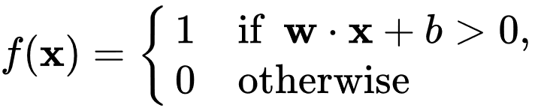
Machine Learning Models
SGD Classifier: Some users could believe that SGD is a classifier based solely on the name Stochastic Gradient Descent - Classifier (SGD-Classifier). Not the case, though! The SGD Classifier is a linear classifier (SVM, logistic regression, etc.) that has been enhanced by the SGD. Using a single sample, stochastic gradient descent (SGD) calculates the gradient. Finally, mini-batch gradient descent combines the best of both worlds by updating for each mini-batch of n training instances.
PERCEPTRON: The perceptron is a technique for supervised learning of binary classifiers in machine learning. Using a vector of integers as input, a binary classifier is a function that can determine whether the input belongs to a particular class.

Slide 14
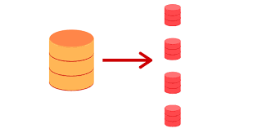
Why use these Machine Learning Models?
These machine learning algorithms may not be the newest but they provide an unreal advantage over other algorithms.
They support the method “partial_fit”, which helps in training large datasets in chunks.
By taking advantage of this partial_fit we can train a large dataset without taking up much space in the main memory.
These algorithms gradually train the data chunks one by one, thereby increasing the efficiency.

Slide 15
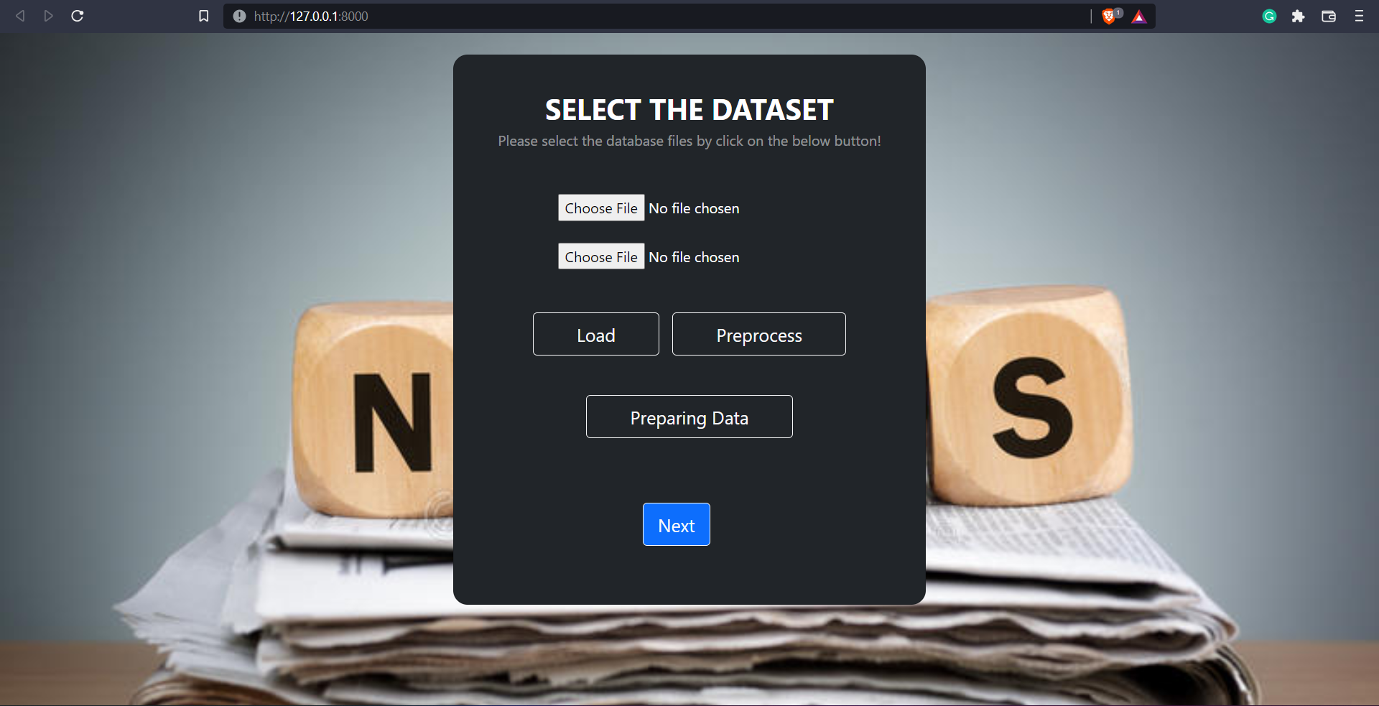
Working of Proposed System

Slide 16

Working of Proposed System

Slide 17
Results and Analysis
TP-True Positive; TN- True Negative; FN- False Negative; FP- False Positive
Accuracy
Recall
Precision
Accuracy= TP+TN
TP+TN+FP+FN
Recall=
TP TP+FN
Precision=
TN
TN+FP
1
2
3

Slide 18
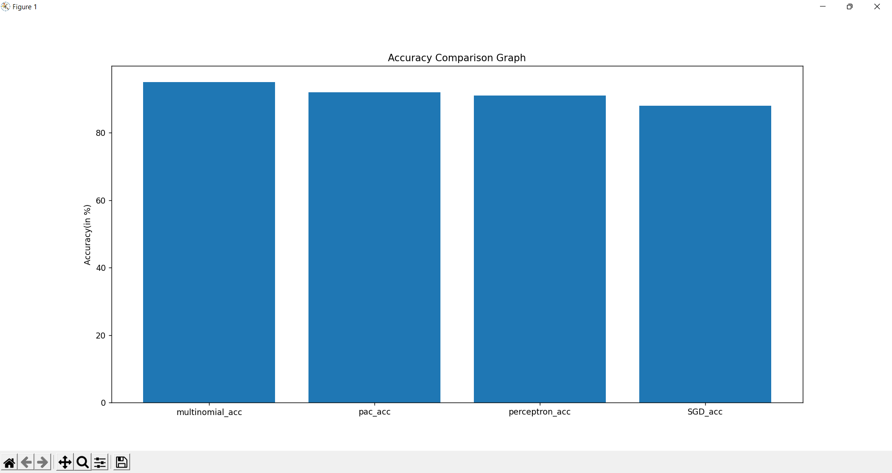
Final Results

Slide 19
Conclusions
Most tasks are completed online in the twenty-first century. Applications like Facebook, Twitter, and online news stories are replacing newspapers, which were formerly favoured as tangible copies. The forwards on WhatsApp are another important source. Fake news, a problem that is only becoming worse, complicates matters and seeks to influence or sway people's attitudes toward using digital technologies. When a person is misled by the genuine news, one of two things may occur: First, they may begin to believe that their impressions of a certain subject are accurate.
In this project, we use the relationship between the words to determine whether a piece of writing is authentic or not. The accuracy for the proposed system is 95%

Slide 20
Future Work
We intend to employ web scraping to independently collect data from numerous social media platforms and websites for usage in our system.
Additionally, we wish to increase accuracy through query optimization.
We want to create our own dataset that will be updated regularly with the most recent information. A database using a web crawler and an online database will be used to store all the most recent information and live news.

Slide 21
Thank You
Fake news
Real news

